Slide 1

AML 2103 Project Store Sales Analysis
BHANU PRAKASH MAHADEVUNI – C0850515
DEEKSHA NAIKAP – C0835440
PRAMOD REDDY GURRALA – C0850493
SAI VARUN KOLLIPARA – C0828403

Slide 2
Problem Statement
Sales are the only way for the survival of any store, so the implementation of advanced techniques that can analyze those sales would be helpful for many stores. The problem states to implement a machine learning model to predict future sales.
For the solution proposed, we have decided to consider the Store Sales Analysis data available on Kaggle and to predict the future sales of products sold at Favorita stores located in Ecuador.
We will be performing all the basic Data Analysis, Data Visualization, Machine Learning Model Building
We will analyze the trend and pattern in sales throughout the timeframe and utilize the XGBoost regression model to predict the expected sales for each product.

Slide 3
Steps Involved
Importing the Packages, Functions and Libraries
Importing and Loading the Dataset
Data Pre-processing
Exploratory Analysis
Data Visualization
Data Splitting
Model Building
Model Evaluation

Slide 4
Dataset Utilized
Store Sales Analysis data from Kaggle - https://www.kaggle.com/competitions/store-sales-time-series-forecasting/data
Data consists of 6 different parts in csv format.
Train
Test
Transaction
Stores
Holiday_events
Oil

Slide 5
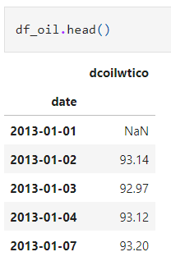
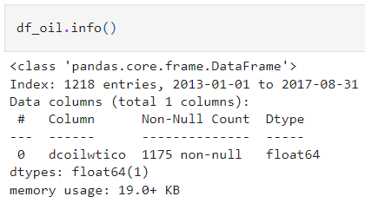
Oil
The Oil dataset has 1 attribute (column) and 1218 instances (records).
The attribute dcoilwtico is numerical.

Slide 6
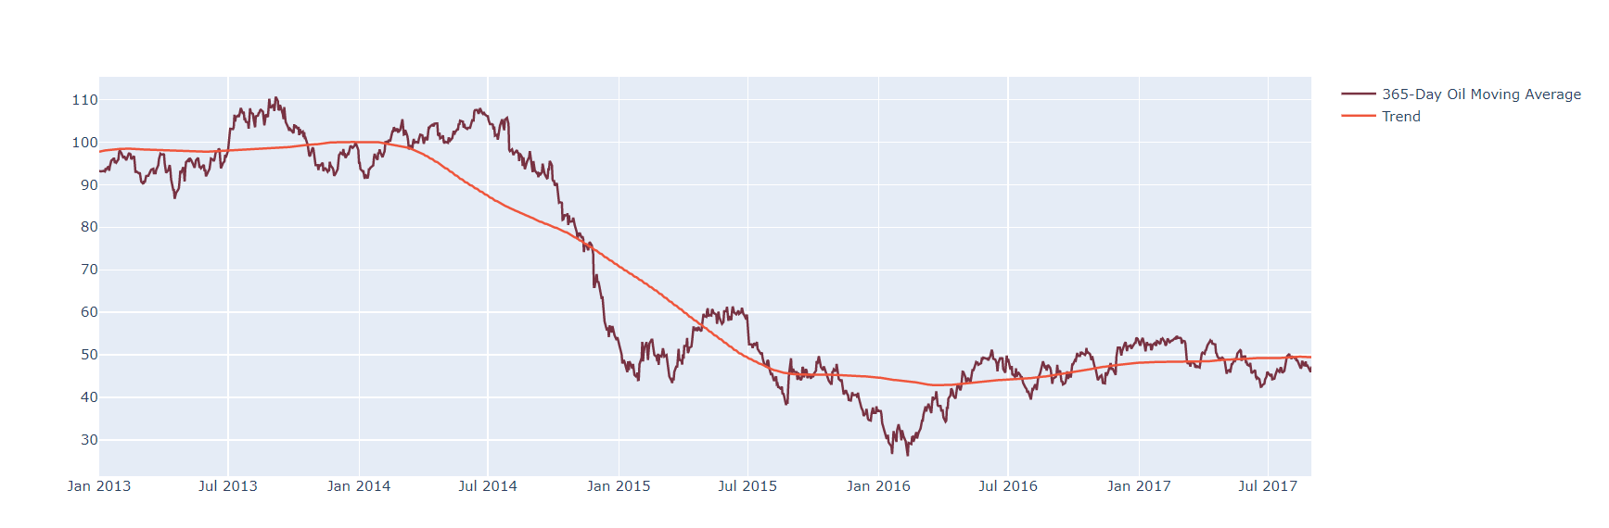
Higher oil prices tend to make production more expensive for businesses
Lower oil prices mean more purchasing power for the customers.
Oil price starts dropping from mid-2014.

Slide 7
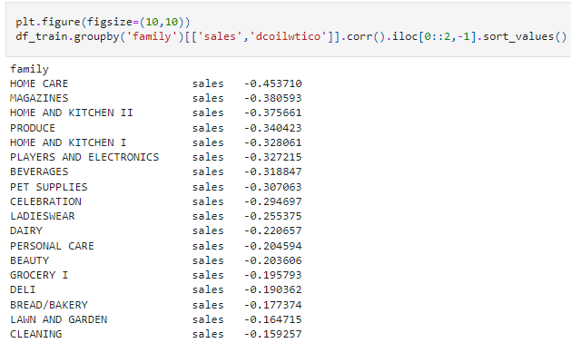
Some of the product families like Home Care, Magazines, Home and Kitchen II, Produce, Home and Kitchen I have slightly stronger correlationship with the oil price.

Slide 8
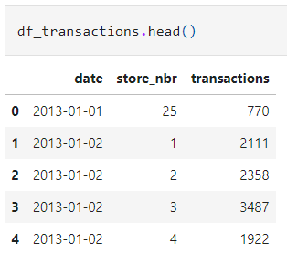
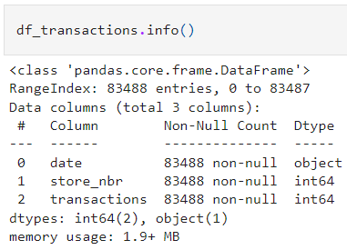
Transactions
The Transactions dataset has 3 attributes (columns) and 83488 instances (records).
It consists of both categorical and numerical attributes.
Date is the categorical attribute. Store_nbr and transactions are the numerical attributes.

Slide 9
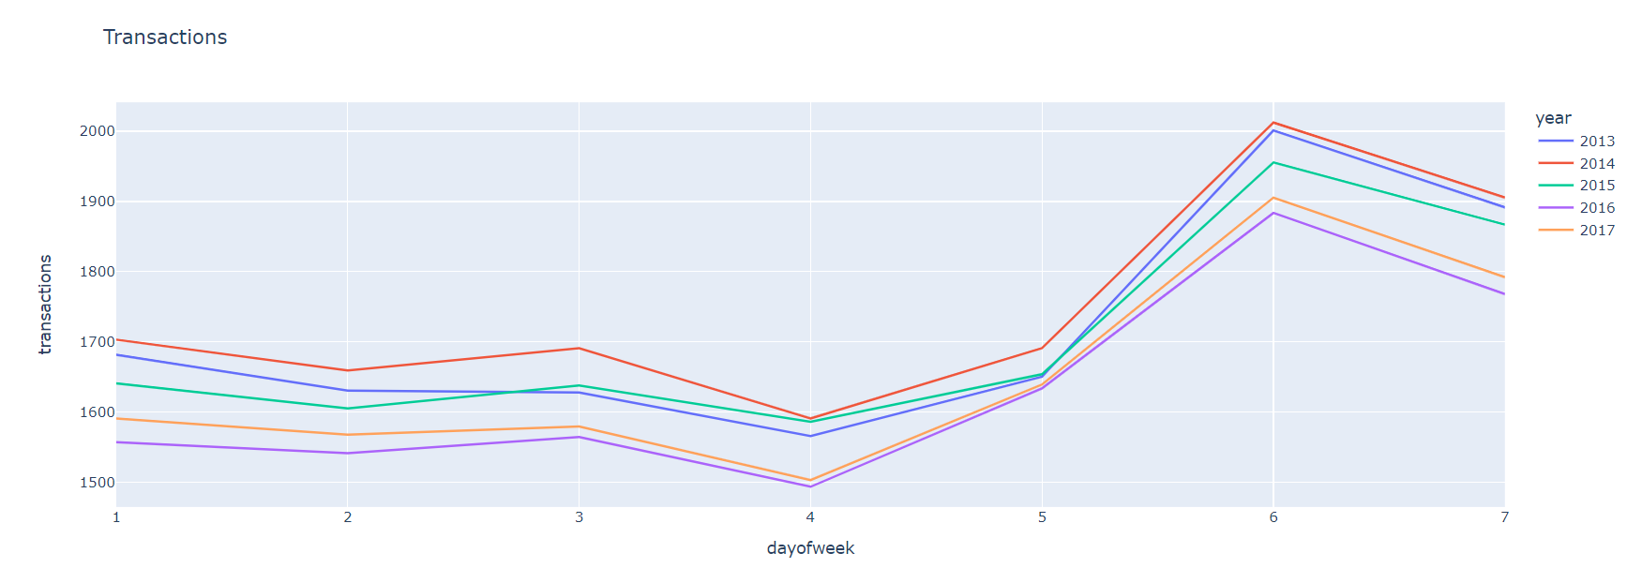
Transactions are more during the weekends compared to the weekdays for all the years from 2013 to 2017.

Slide 10
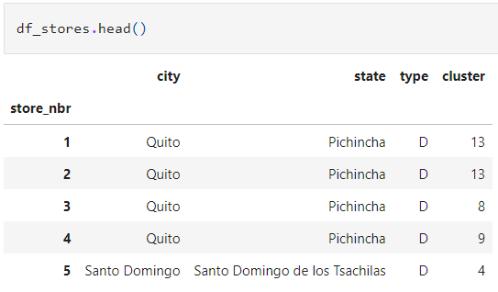
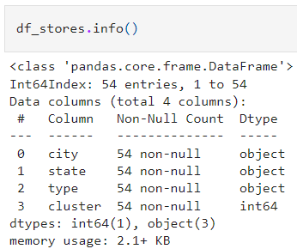
Stores
The Stores dataset has 4 attributes (columns) and 54 instances (records). It consists of both categorical and numerical attributes.
City, state, and type are the categorical attributes. Cluster is the numerical attribute.

Slide 11
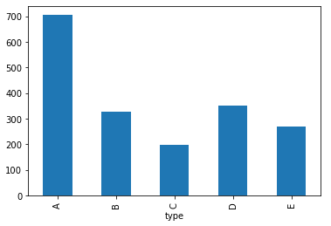
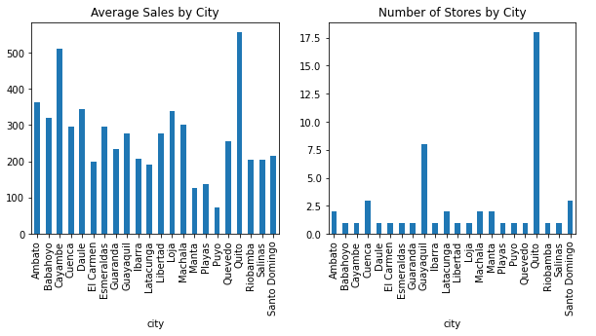
Type A looks like a biggest type of store and Type C is the smallest size of store.
The city ‘Quito’ has the highest number of stores and therefore it has higher sales.
Even though the city ‘Cayambe’ has fewer stores, it has higher average sales.

Slide 12
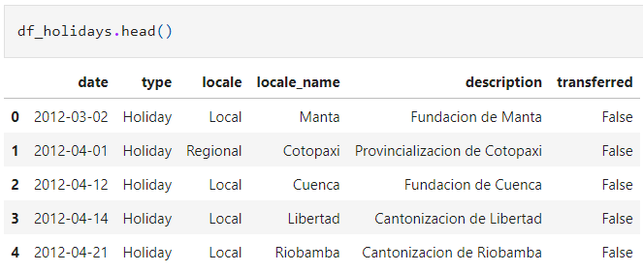
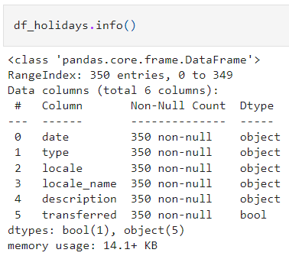
Holiday
The Holiday_events dataset has 6 attributes (columns) and 350 instances (records).
Date, type, locale, locale_name, and description are the categorical attributes.

Slide 13
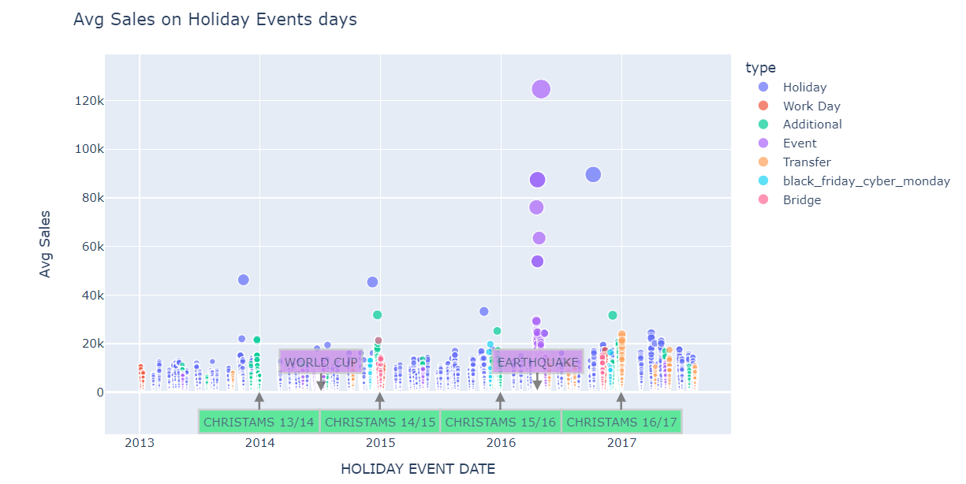
In the chart we can confirm the average increasing trend in sales.
We can clearly see two zones with purple bubbles on consecutive days.
The purple bubbles of June 2014 correspond to the Football World Cup.
The purple bubbles of Apr 2016 correspond to days off given by the goverment due to the earthquake.
During these two events, the sales went up.

Slide 14
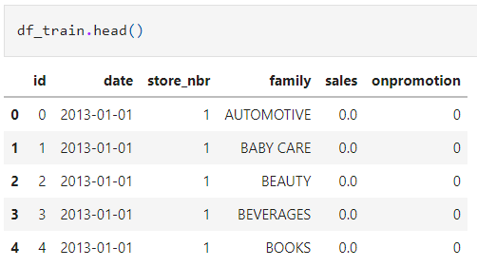
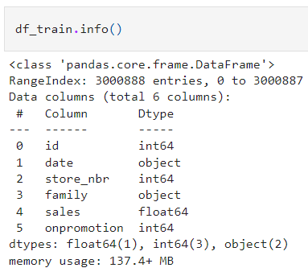
Train
The Train dataset has 6 attributes (columns) and 3000888 instances (records).
It consists of both categorical and numerical attributes.
Id, store_nbr, sales, onpromotion are the numerical attributes. Date and family are the categorical attributes.

Slide 15
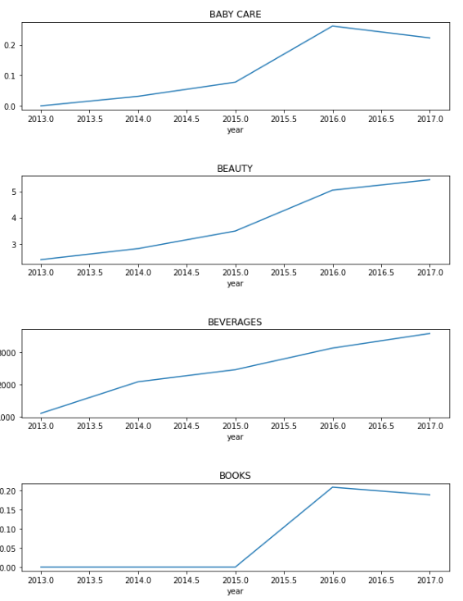
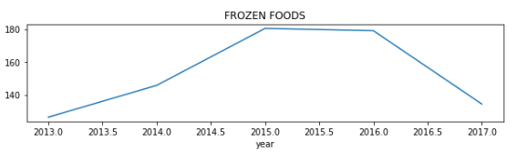
Yearly Growth of Product families
There's an increasing trend in sales every year.
Almost all product families were growing stably to 2017.
There are some exceptions for the tendency. Frozen foods, baby care, and liquor,beer, wine sales decreased from 2016.

Slide 16
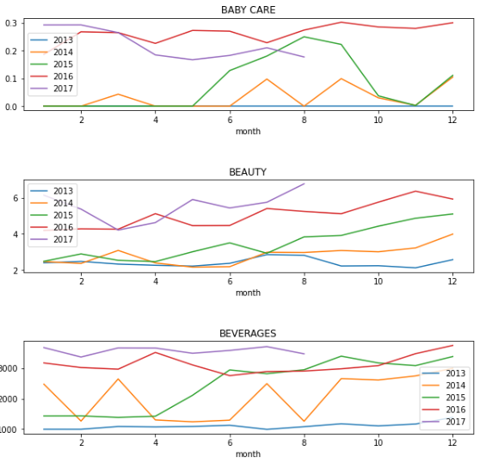
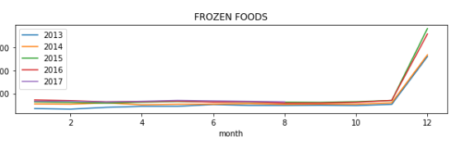
Monthly Sales by Year
Frozen foods are obviously affected by the Christmas season.
Baby care products sold well in 2016 from August to the end of the year.

Slide 17
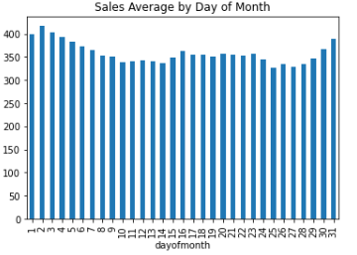
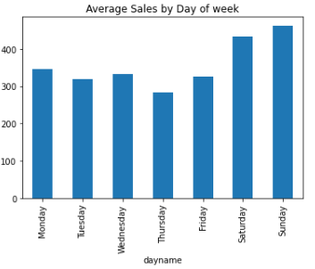
Average Sales by day of month
The sales are comparatively high around the paydays.
Average Sales by day of week
During the weekends customers purchase more compared to weekdays.

Slide 18
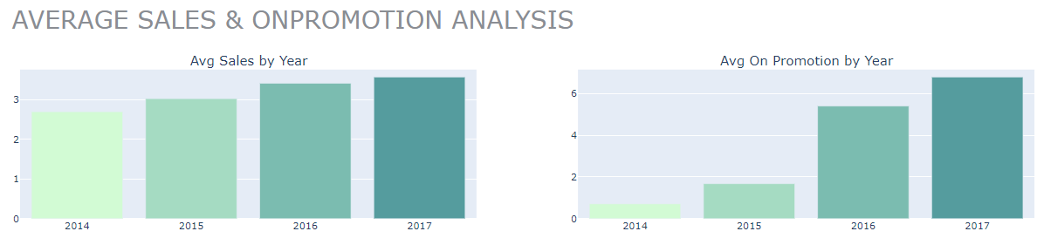
There has been an exponential increase in promotions throughout the years.
There aren’t any promotions in 2013.

Slide 19
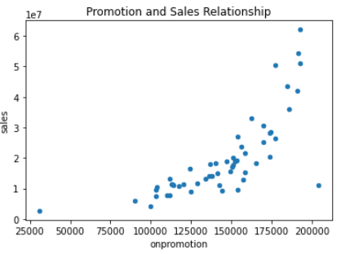
Correlation between OnPromotion and Sales
There is a positive correlation between onpromotion and sales units sold.
When more items of the supermarkets are on promotion, it's more likely to sell them.

Slide 20
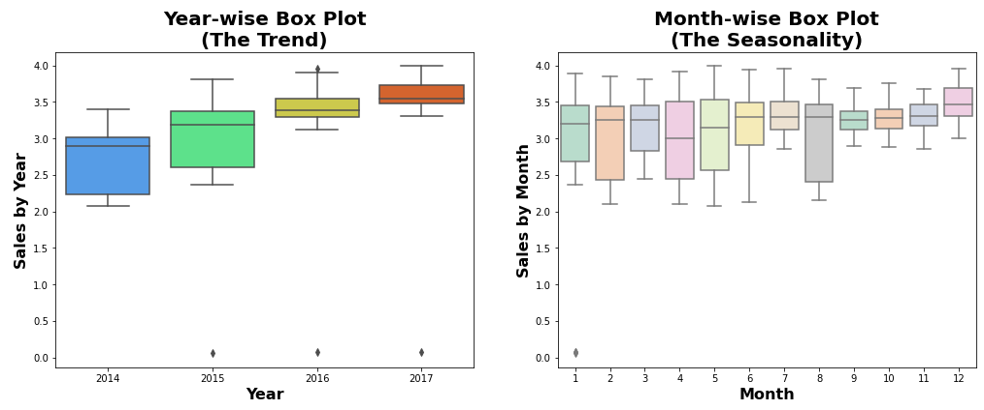
Seasonal plot of sales
We can see different seasonal patterns in the year and month.

Slide 21
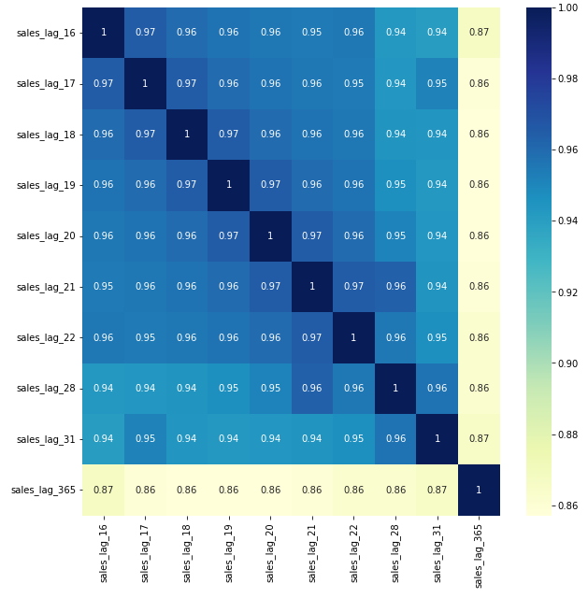
Heatmap of Lag feature

Slide 22
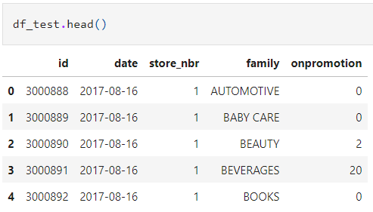
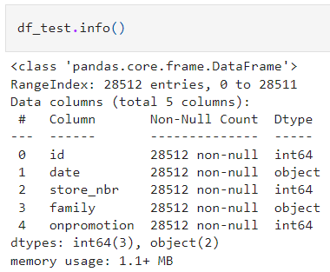
Test
The Test dataset has 5 attributes (columns) and 28512 instances (records).
It consists of both categorical and numerical attributes.
Id, store_nbr, and onpromotion are the numerical attributes. Date and family are the categorical attributes.

Slide 23
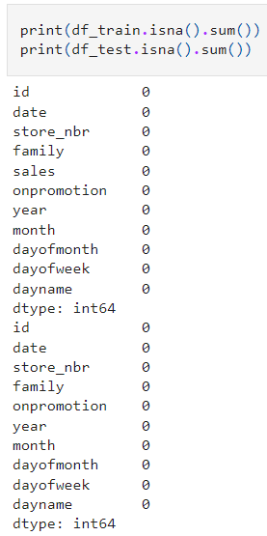
Missing and Null values
There aren’t any missing values and null values in our train and test datasets.

Slide 24
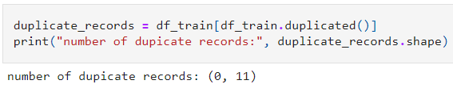
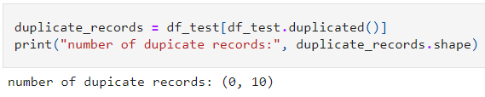
Duplicates
There aren’t any duplicate records in the train and test datasets.

Slide 25
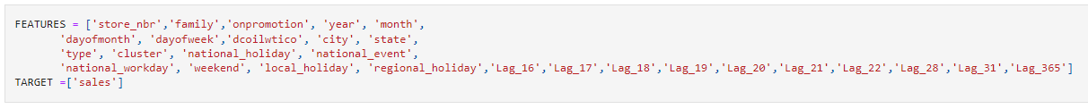
Data Splitting
Data Splitting is a stage where the data is decided and assigned to multiple variables that will be used in the future for training and testing the model. (This is a primary step for every machine/deep learning model building)
The data can be split into training, Testing

Slide 26

Model Building
The foremost step for every machine learning / deep learning is to build a model based on the data.
We have used XGBoost algorithm to build the model.

Slide 27
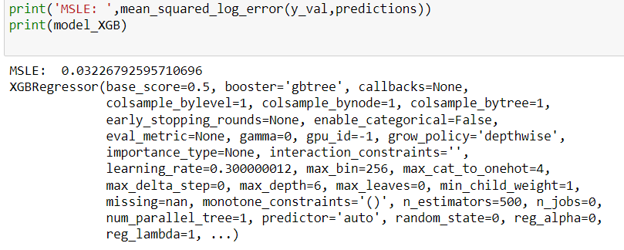
Model Evaluation
After Building a Model we need some Metrics to classify the results.
We need them to compare the performance of any Machine Learning Model.
We are using mean squared log error of the XGBoost model.

Slide 28
Conclusion
We used XGBoost regression algorithm to built the model for predicting the future sales of products sold at Favorita stores.
The sales and transactions are higher on the weekends compared to the weekdays for all the years from 2013 to 2017.
The oil price started dropping from July 2014 and showed a negative trend afterwards.
There is an exponential increase in promotions throughout the years, which increased the sale of those items, as onpromotion and sales unit sold are positively correlated.
Future development - The insights from the results can be implemented in multiple stores to analyze the report from the machine learning models. Based on the performance, the scale of the implantation can be increased.

Slide 29
References
https://www.kaggle.com/competitions/store-sales-time-series-forecasting/data
https://realpython.com/linear-regression-in-python/
https://machinelearningmastery.com/xgboost-for-regression/
https://realpython.com/python-matplotlib-guide/
https://www.w3schools.com/python/numpy/numpy_random_seaborn.asp
https://towardsdatascience.com/exploratory-data-analysis-in-python-a-step-by-step-process-d0dfa6bf94ee
https://www.analyticsvidhya.com/blog/2021/05/dealing-with-missing-values-in-python-a-complete-guide/
https://www.simplilearn.com/tutorials/python-tutorial/data-visualization-in-python#:~:text=Python%20offers%20several%20plotting%20libraries,most%20simple%20and%20effective%20way

Slide 30
THANK YOU

